Slide 1

Deep Learning on UAV Videos for Visual Inspection of Structural Audit
Aditya Shenoy – 161080036
Rahul Bhoir – 161080063
Kalyani Borkar – 171081990
Rani Deore – 171081993

Slide 2
Problem Statement
The proposed system should be able to capture video images using UAV, which will be processed for detection of cracks, dampness and paint peel-off using neural network as a part of visual inspection while doing structural audit of infrastructures.

Slide 3
Model Trial 1 – Dataset
We took out 80 samples from the camera images that we captured.
With 7 transformations on images, which does not cause any distortion, we scaled the dataset size by 8 (1 original and 7 transformations) leading to 640 images.
Then we used Keras’ Image Data Generator which performs random distortions on the image.
This data generator prevents the model to be overfitted.
Using these distortions, we scaled the image to final dataset size of 80,000 images.

Slide 4
Model Trial 1 – Model Architectures
We decided to try 2 types of architectures for training the model – Neural Network (NN) and Convolutional Neural Network (CNN)
When we tried NN, every architecture (tried almost 100 architectures) had a varying training accuracy but was stuck at 25% testing accuracy.
Then when we tried CNN, we got not only good training accuracy but also good testing accuracy.
When we plotted the graphs of Accuracy vs Epochs and Loss vs Epochs, we found out that it was slightly overfitting on our dataset

Slide 5
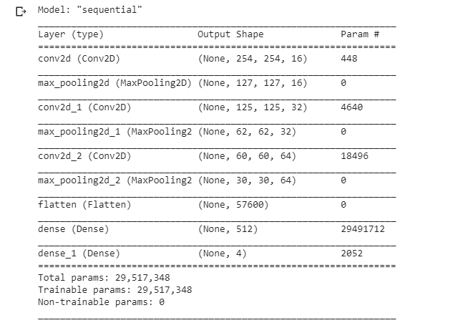
CNN architecture structure

Slide 6
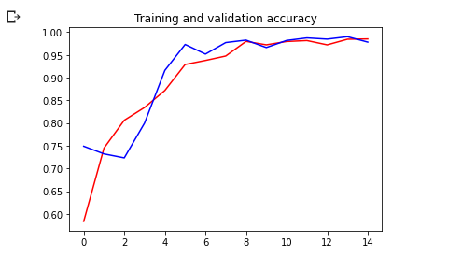
Accuracy vs Epochs

Slide 7
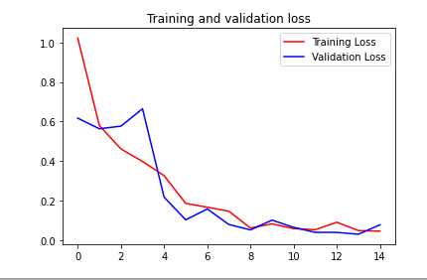
Loss vs Epochs

Slide 8
Model Trial 2 – Dataset
Now, we are trying to add more variety to the dataset as previous model was overfitting probably due to lack of original samples that we started with (i.e. 80).
So, we cropped 625 images from our captured camera images for each class (4 classes – Crack, Dampness, No Defect, Paint Peel Off) resulting to 2500 images in total.
We then applied the same 7 non distorting transformations as before and scaled up the dataset size by factor of 8, resulting to 20,000 images.
We are using Keras Image Data Generator but this time it is not scaling up the dataset size but just adding random distortions on the original images.

Slide 9
Model Trial 2 – Architecture
As from the previous trial, we came to know that CNNs perform better than NN for this task, we are using the same architecture this time too.
We have achieved 91% testing accuracy using this architecture this time.
The model this time does not seem to be overfitting.

Slide 10
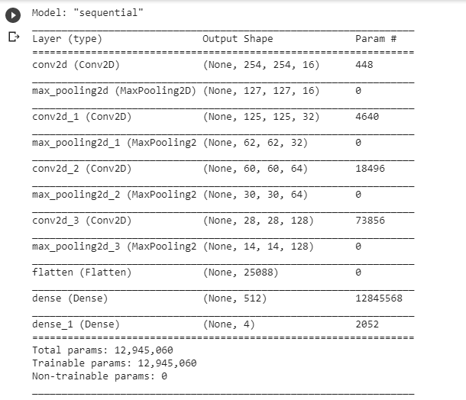
CNN architecture structure

Slide 11
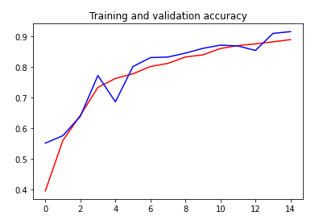
Accuracy vs Epochs

Slide 12
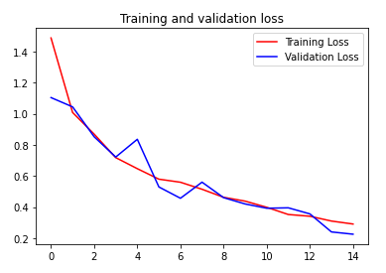
Loss vs Epochs

Slide 13
Next steps…
Now, as the model is performing well for images, we will use the same model for video frames (which are images too).
We will use a sliding window mechanism to detect wall defects in the sub-images (of dimensions 256*256) of the original big image.
Currently we will record this video using our phones and apply batch processing on the video.
We will take a note of how much time the model takes per frame to do its prediction.
Based on this timing, we can plan to use the same model for real time video data with an expected lag of the above time.

Slide 14
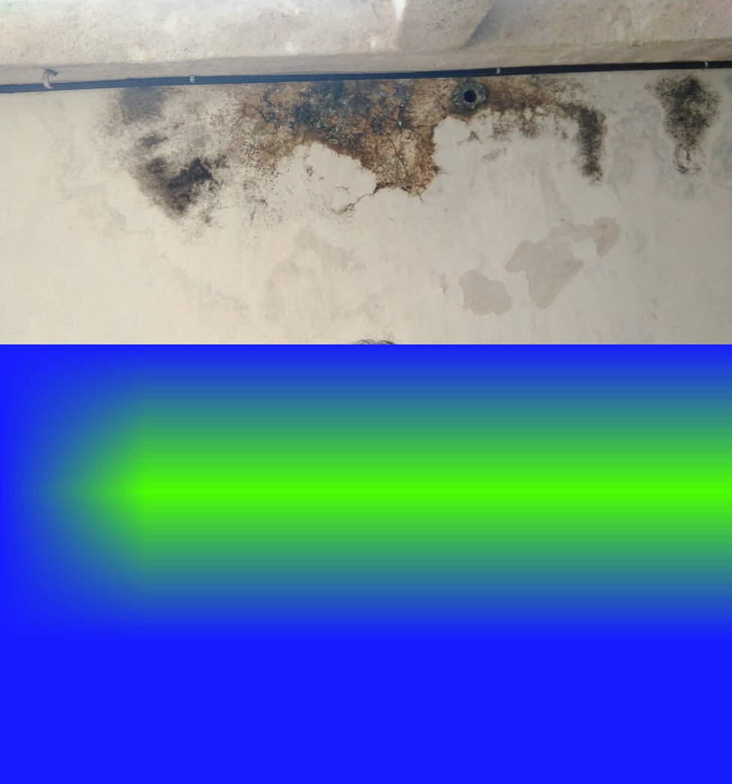
Sliding Window Illustration
The top image is the input image.
The model should highlight the regions with color coding in the output image as shown in the bottom image.
Here blue indicates wall with no defect, green indicates dampness, and likewise other classes can be color coded.

Slide 15
Thank You

